Slide 1

Introduction to cypress
(Not Sponsored)
** Opinions and view points in this presentation may not be the opinions and viewpoints of anyone.
Notes:
Welcome, to my Introduction to Cypress
If you have any questions during the presentation, please add them to the chat and I will try and come back to them at the end and answer as best I can.

Slide 2


Introduction
Who am I and what is todays Agenda
What is cypress / what is it not.
Simplified case study
Pitfalls and best practices unique to Cypress
Notes:
I am Philip Jory, I am a full stack software engineer and have been at Albelli for about 2 years.
Today I will be giving a brief introduction to cypress and walking through a couple of simplified case studies with a focus on problems encountered and best practices to avoid or minimise them.
Cypress has good documentation available online so make sure to check it out

Slide 3
What is Cypress
https://www.cypress.io/
The web has evolved. Finally, testing has too.
Fast, easy and reliable testing for anything that runs in a browser.
Runs fast tests in the browser
Cypress is free*
SaaS model
*Parallel scheduling = $$
Notes:
So, What is cypress.
They have their own marketing department and you can checkout their full sell online at cypress.io
But essentially it is a testing framework that’s runs its tests from within the browser
Cypress is fast to run, easy to write tests for, well documented and free to start with, they do operate a Software as a service model
And their unique selling point is related to their parallel scheduling, which I will come back to shortly.

Slide 4
What is cypress not
Not a general purpose automation tool.
Runs inside of a single browser tab browser.
You cannot use Cypress to drive two browsers at the same time.
It will never support multiple tabs
Notes:
But first I think its helpful to define what cypress is not.
Its not selenium or related to selenium.
Its not a general purpose tool, it specifically runs in a single browser tab and has good connections to the application code in the browser because of this.

Slide 5
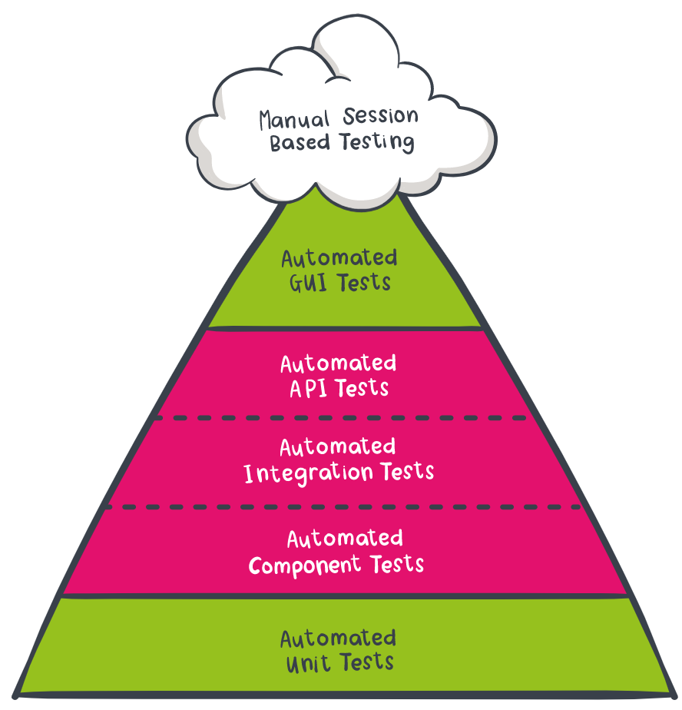
What is cypress
Limitations prevent it from testing every possible GUI scenario.
I.e. limited to certain web browsers
Quicker and easier to use and setup than other more complete UI testing applications and well integrated with the browser
Mocking and stubs allow you to test in isolation
Notes:
Due to those limitations it can’t completely satisfy all possible graphical test requirements, however it is arguably quicker to write and run cypress tests and make them reliable (I for example can remember automation tools that took over the mouse and clicked on specific pixel locations on the screen or took screenshots to analyse differences, but because cypress is well integrated with the browser its runs faster and more reliably) Meanwhile it also offers mocks or stubs which allow for testing in isolation
So I think has a bit of hybrid location in the testing pyramid and can cover various scenarios depending how you use it.

Slide 6
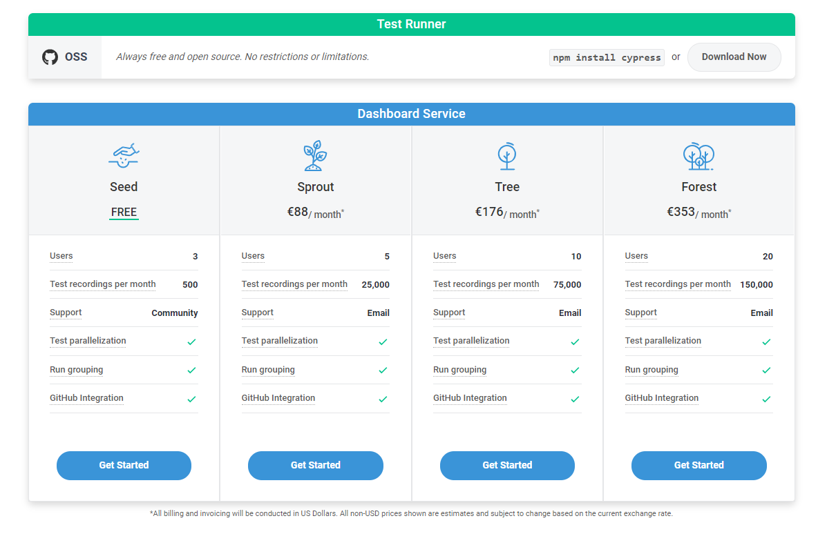
Notes:
How much it costs may or may not be relevant to you
Although their unique selling point being the parallelisation and how their licencing relates to that makes it clear what you are paying for and therefore also what you get for free.
The testing framework itself and the features are same regardless, its simply a matter of how heavily you use it and there are creative ways to interpret that as well.
Because a test run, is a full set of tests, this could be running tests against a single microservice or even an entire environment Its really up to how you use it.

Slide 7
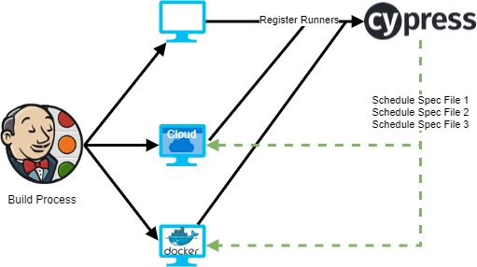
How does parallelism work
Notes:
I think its worth taking a bit of side bar and talking about how parallelisation works with cypress while we are here.
Essentially some process, making use of several machine instances, whether they be actual machines or docker images, registers and triggers a cypress run and cypress then takes care of the scheduling.
This is their big feature. This is the money maker. This is what you pay for.

Slide 8
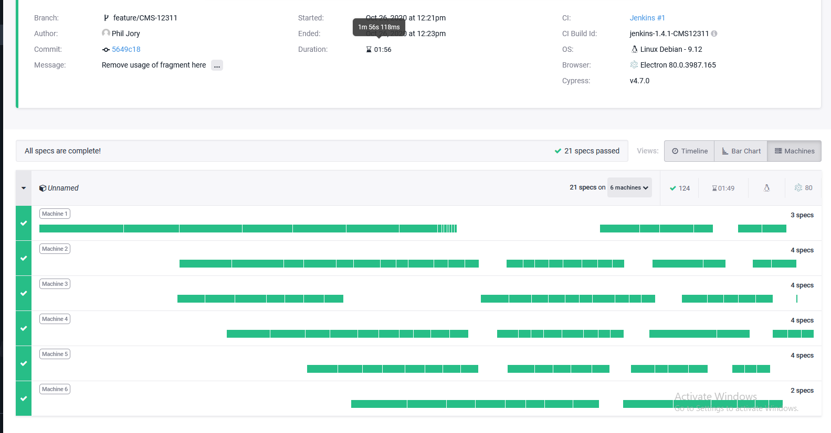
Notes:
Looking at it in the cypress dashboard you can see the results of running some spec files in parallel, against a single application and environment, here we have 21 spec files running across 6 machines with a total of 124 tests and it takes less than 2 minutes
These machines don’t all start at the same time in this example and you can see how cypress splits the test run by spec file and schedules them as machines become available.
I find it to be surprisingly efficient with its distribution of tests, it does a good job of the machines all being finished at the same time

Slide 9
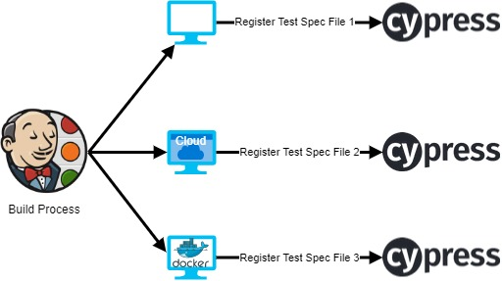
Can you run in parallel for free?
Yes! (see I told you I wasn’t sponsored)
Notes:
But can you run in parallel for free?
And yes of course you can, the cypress parallel scheduler can be completely bypassed and you can schedule the individual spec files or you could just run them all in serial on one machine

Slide 10
Can you run in parallel for free?
it might not be worth it
Dashboard and uploading of videos on failure
Parallelization is less efficient
You get many runs for your subscription
Custom payment plans exist
It might be useful in some scenarios
Notes:
But it might not be worth it, the number runs you get for your licence is deceptively large and
You would lose out on the dashboard and cypress has obviously put a lot of work into their scheduling process which I imagine it would be difficult to replicate.
However it might be useful in some scenarios

Slide 11
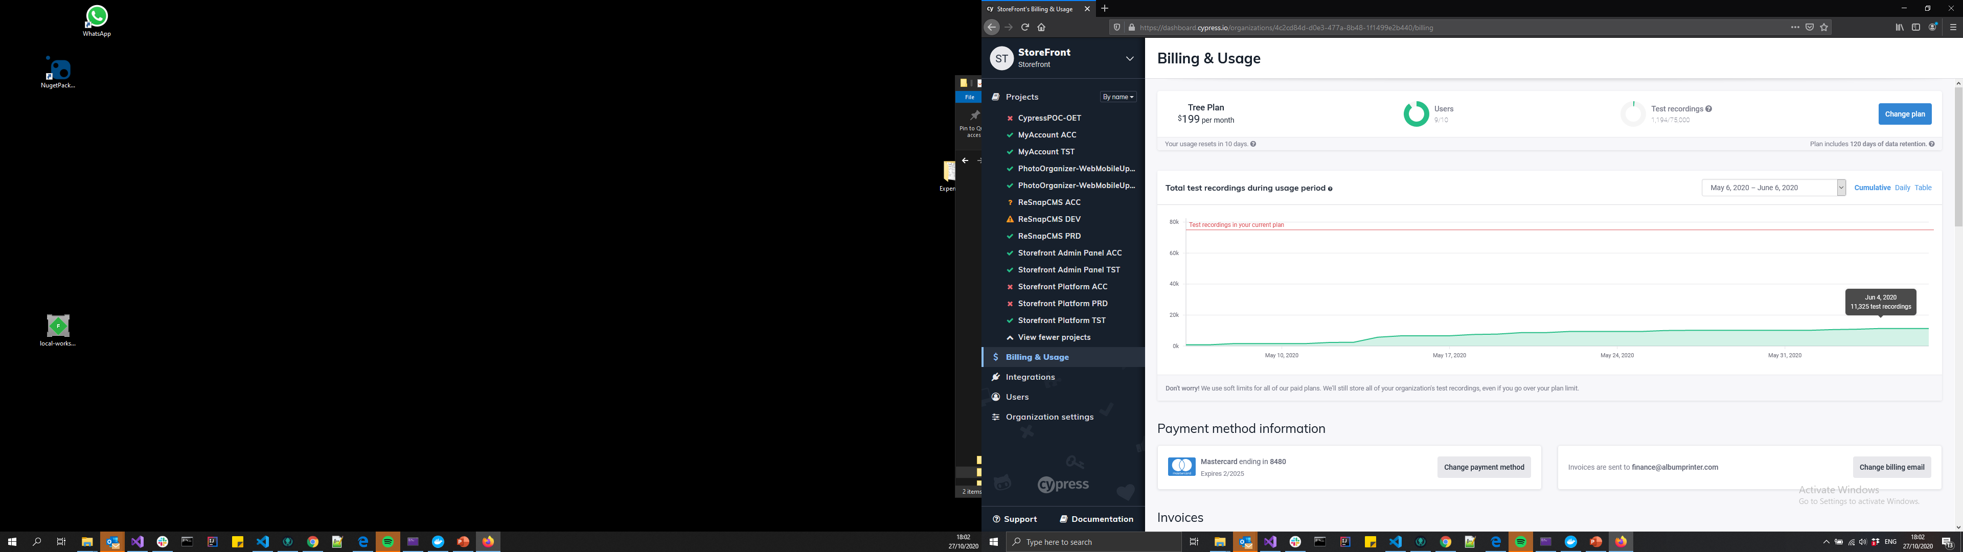
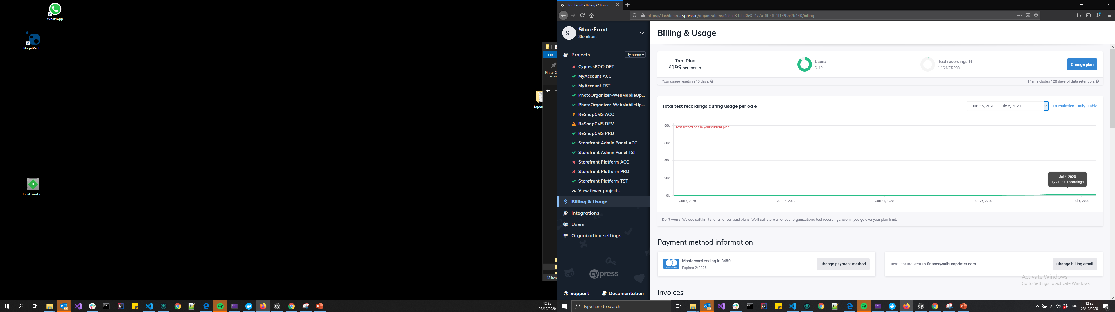

Total Test Recordings- What do we use
Notes:
Just taking a quick look at some real life data for this, What you see here is a cypress dashboard for several actively developed applications, June where we did some load testing or similar and a more regular month of July Given the free licence is for 500 runs a month and the first paid for licence is 25,000 runs per month. we on a regular month would barely pass the free limit and even when we hit it hard we still have difficultly hitting the next limit

Slide 12
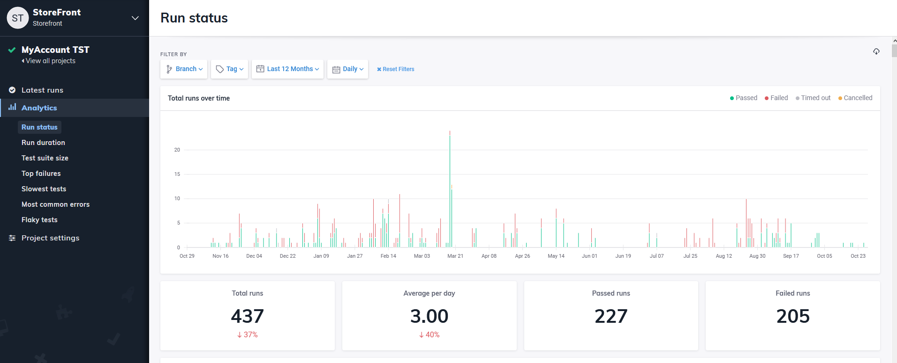
Total Test Recordings- What do we use
Notes:
Again just some real data from cypress, this is a full year of runs against a single application that is still under development but was definitely more so at the beginning of the year, 2 developers and there are unit test so this is not representative of all check ins but of all test runs.
(you use less than you expect)

Slide 13
Case Study – Albums (Loading Data)
“Albums” app
Accesses an open API that returns placeholder data & displays them
For the top 10 albums it loads all the photos in the album
A button is provided to load the phots of other albums
Notes:
So now we know what cypress is and how it works and what is special about it but how do you use it. So I created an application which makes some web requests, displays some data and then proceeded to write a few tests for it. First up the application.

Slide 14
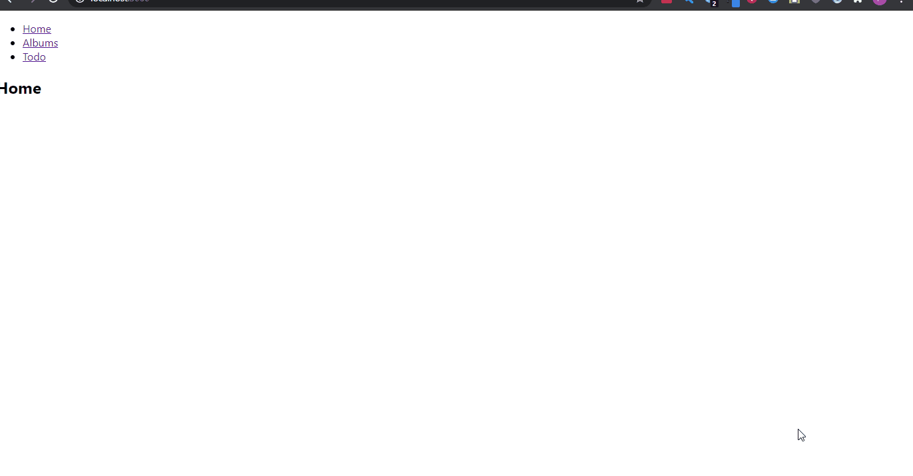
Case Study – Albums (Loading Data)
Notes:
As you can see here, the application first loads all albums and for the first 10 albums the photos contained in those albums, then for any other albums it will provide a button which the user can click on to load those pictures.
Nothing complicated just an application that makes some deferred web requests.

Slide 15
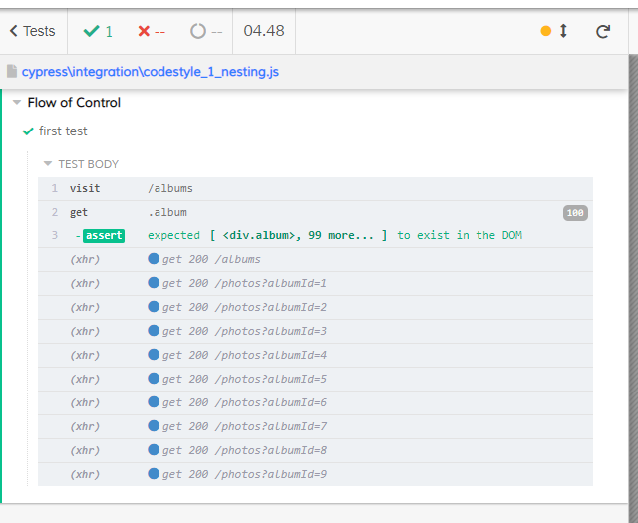
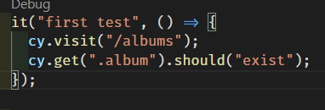
Case Study – First Test
Website Loading
Notes:
And we write the first test. So basic structure of test we can see is
It is our first test
we visit the albums page
Then we get the album element and assert that it should exist
And we can see on the right, the cypress runner, where these steps match up and the following completion of web requests it makes on load.

Slide 16

Code Style / Flow of Control
Cypress supports a mixture of asynchronous (promises) and synchronous code styles
Cypress will always execute code the in a synchronous manner
The next 3 examples all result in the same execution but the clarity offered by the code differs
Notes:
Now that we have seen a simple test, lets take a little look at flow of control.
Cypress supports both an asynchronous and synchronous style its worth knowing that it always executes in a synchronous manner. I have some examples which hopefully demonstrate this well

Slide 17
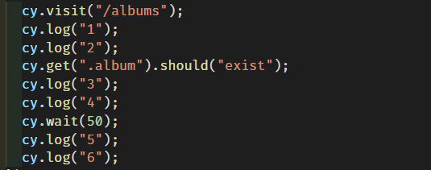
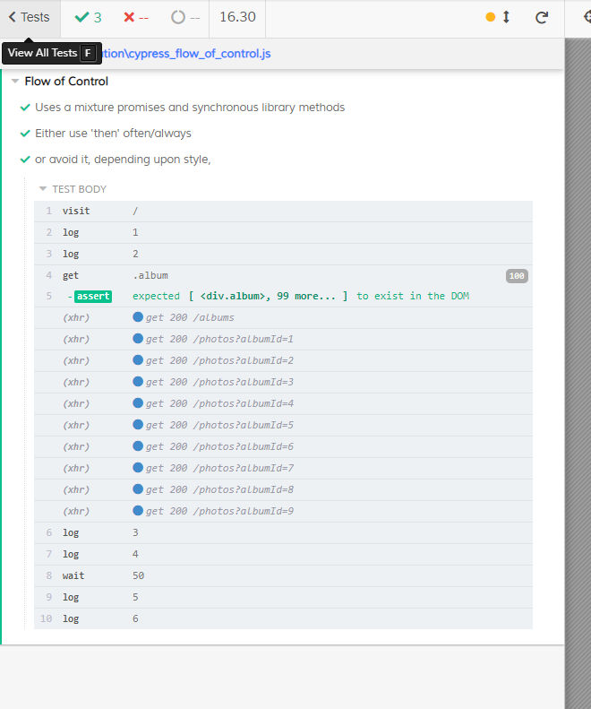
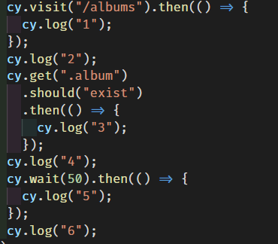
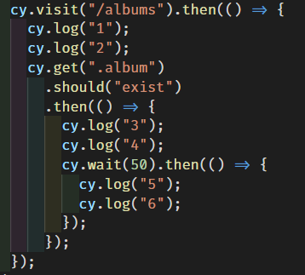
1.
2.
3.
Notes:
All 3 tests shown here execute the same way the first test is perhaps the most obvious, it avoids all nesting and promises entirely.
The second is has a bit more of a random approach
While the third test prefers nesting
they all have the same output, and really this is a question of design or style, and while 1 is straightforward and 3 still makes sense the second there is just a mess but with a more complicated example we can see how this could potentially add value

Slide 18
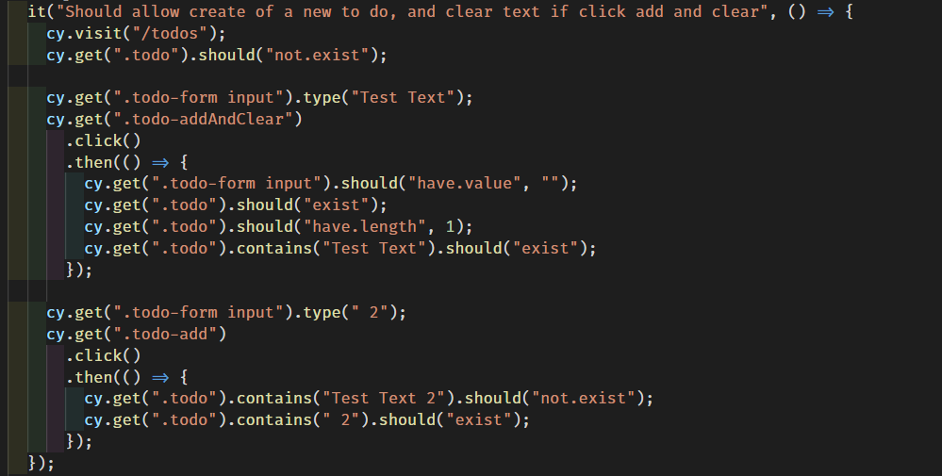
But nesting can add meaning if used appropriately
Notes:
So in this example which is actually for the next part of the case study which we will see shortly provides a nice example of meaningful nesting.
Hopefully its obvious that there are 3 parts to this test

Slide 19
But nesting can add meaning if used appropriately
Visit Page
Setup
Click Button
Assert Results
Setup
Click Button
Assert Results
Notes:
We have the initial setup and visit of the page, where we visit the todos page and check that to do items should not exist
Then we get the todo form input field and type the text Test Text, we get the todo add and clear button click on it and then assert several conditions related to that button click.
After which we return back to the main flow and continue with our test and do a similar similar check

Slide 20
Case Study – To Dos (executing actions)
“ToDo” app
Stores data in local storage
User can
Add and keep their text
Add and clear their text
Remove existing items
User can not add an empty item
Notes:
So the other side of this case study, is a fairly simple action based application that will record a list of to dos

Slide 21

Case Study – To Dos (executing actions)
Notes:
As you can see here, the todos application allows the user to type text into a plain input field
There are 2 options provided, the user can add the item to the list and clear the text box
They can also add the item to the list, keep the text and edit and add again.
Finally have the ability to remove an item from the list
And then I wrote a test for this flow.

Slide 22
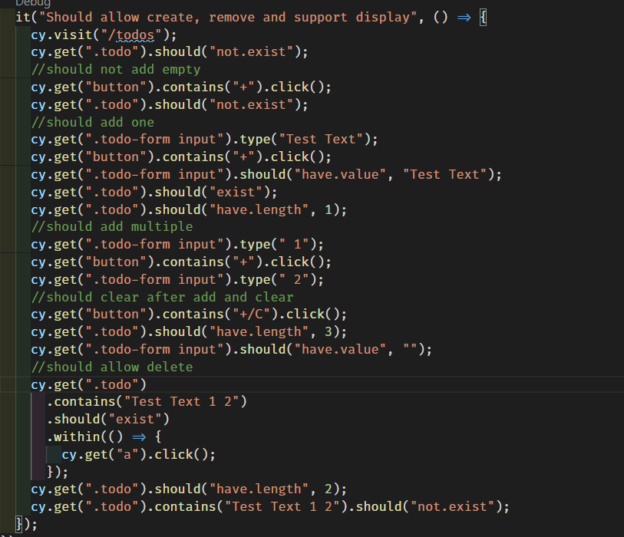
Notes:
Done.
Test everything in one test, we know at the start there will be no data and each step in the test can prepare the state for the next assertion, with some thought we have the application run through all its various potential states.
This should look somewhat familiar to the nesting example but without much nesting, we still visit todos, get that no todos should exist and so on
This is a good example of how the first scripted tests I ever wrote looked and honestly probably still would write tests like this on a first pass and leave them there if it’s a particularly simple application

Slide 23
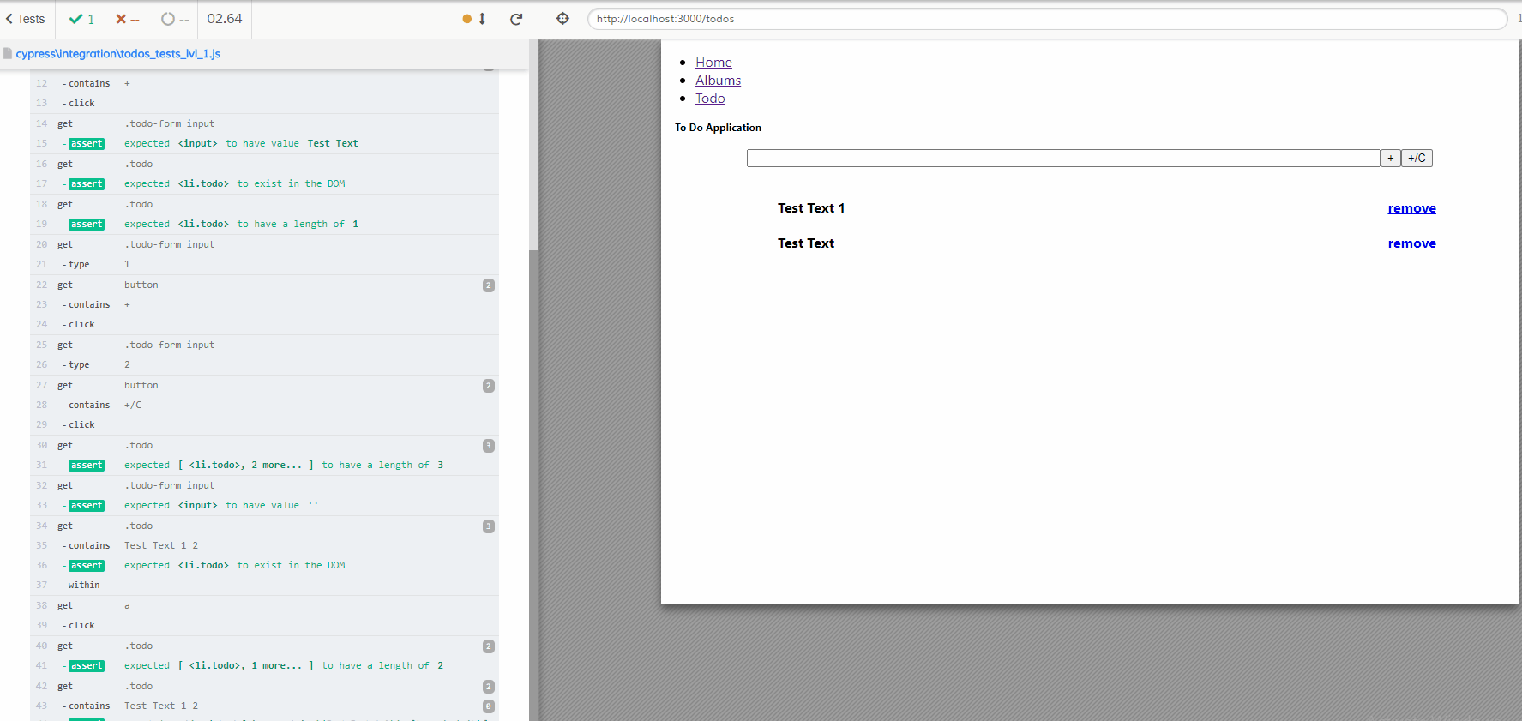
Notes:
Whats wrong with it?, it runs, it passes, that’s what I expect.
But you know the maxim, expect the unexpected.
So lets take another look.

Slide 24
Visit Page
Test
Validation
Test
Add
Test Add
and Clear
Test
Delete
Notes:
We can see this test is clearly testing different things, and without going too much detail on the benefits of testing in isolation
If we break add for example and we also break delete it would take at least 2 passes including fixes to figure this out.
There is also a question maintainability, should we start adding assertions in here it will get harder and harder to read, and also being able to add a new test without risking the existing tests. If we were to add the ability to Update, the test would need to be sandwiched in here somewhere and possibly cause problems (the more complicated the test the bigger an issue this is)
Things that were checked before may pass by accident now, etc.
And It sets a bad precedent for future extension because everything goes here. With that said, id like to take a little bit about some common Cypress specific pitfalls from their documentation which will also add to the understanding of how it works.
Then we will come back to this test and make it the best test it can be.

Slide 25

Pitfalls Retry & Waiting
Always check at least one thing (e.g. should(“exist”)) if you look it up
Checks work like check points in the cypress flow
Once a check passes it will not be retried
Cypress build in checks will automatically retry
There is a default timeout
Waiting before checking (and starting the check/retry cycle) can increase reliability
Notes:
Cypress will automatically retry its assertions a number of times with a default timeout.
First, always assert something, because these assertions work like check points and the automatic retries which while undoubtable valuable can in certain scenarios give the appearance of instability, where a test succeeds one day and fails the next based on how long previous request may have taken. One of the methods to moderate the retry issues is to use waiting.

Slide 26
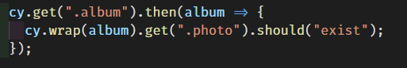
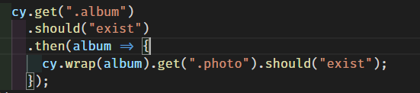
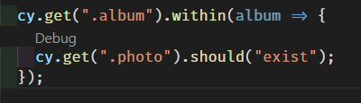
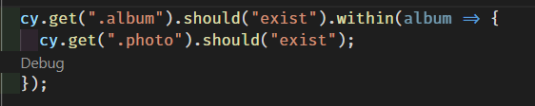
Pitfalls, Retry
Get ParentItem (it doesn’t exist)
Get From ParentItem (null) internal Child Item (it doesn’t exist)
Check Child Should Exist (it does not *see above)
Cypress automatic retry from previous get => 2.
Get From ParentItem (null)
Get ParentItem is not called again, so its children will never be found.
Get ParentItem (it doesn’t exist)
Check Child Should Exist (it does not *see above)
Cypress automatic retry from previous get => 1.
let’s say it does exist next time
Get From ParentItem (found) internal Child Item (it doesn’t exist)
Check Child Should Exist (it does not *see above)
Cypress automatic retry from previous get => 3.
will retry until it passes or times out
Notes:
A little bit of a code example to explain what I mean by these retry issues and its affect on stability. Imagine the albums application, when it first loads it is blank, it then requests its albums and then for each album requests the album photos, so there are various states in the application.
In the first test we
get the albums and then using that album we get its related photos and check at least one will exist. When we first get the albums they have not been loaded, so there will be no related photos. Then the automatic retry will kick in and as it retries from a reference to an album that did not exist when it was got it will never have related photos. If like in the second example we first assert that the album should exist before then checking for related photos, when the retry occurs it will retry that the album should exist and therefore be in a position to get its related photos.
It is worth mentioning that this cy.wrap function is an older syntax and I suspect that cypress has solved some of these using the within function. Which is way its always worth checking the documentation.

Slide 27
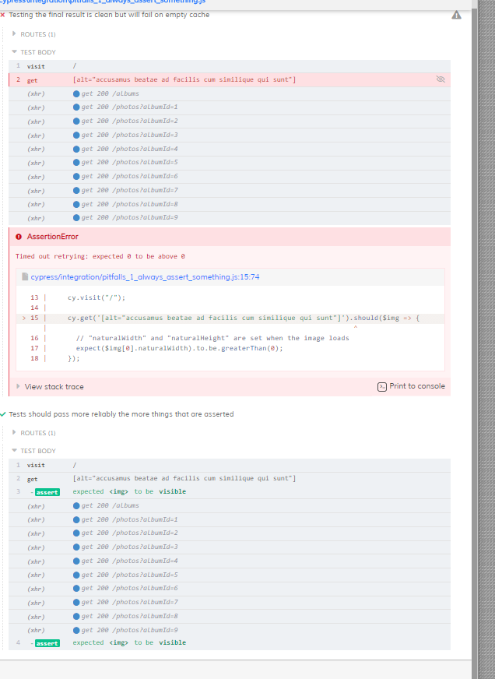
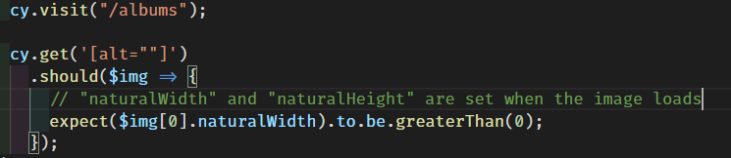
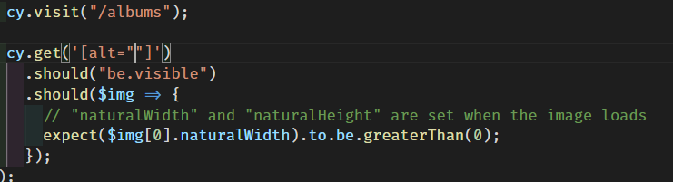
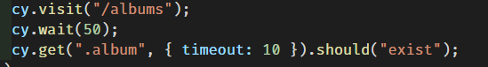
Pitfalls, Retry & Waiting
Rely upon the automatic retry
One possible solution would be to manually wait
Notes:
Further on retry issues.
We can see in the first example which is a manual assertion which is not automatically retried that the test simply fails.
The second example however shows the check that the image should be visible occurs twice, once before and once after the fetches of photos are complete.
One possible solution would be to manually wait, and in this final example I wait for 50 milliseconds which is enough time for the first phot to load, which leads us nicely into another pitfall.

Slide 28
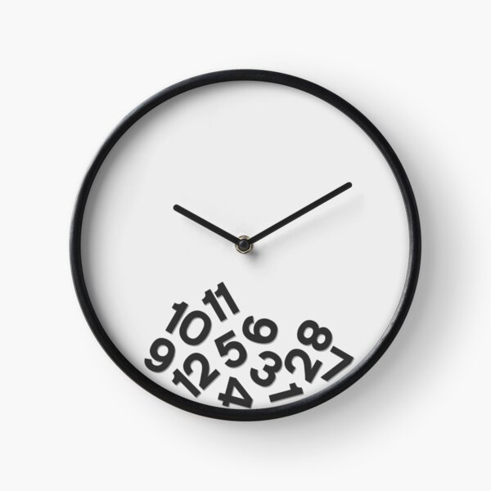
The Problems with Waiting
Waiting for arbitrary times is an anti-pattern
Waiting for things that are outside the scope of the test is wasteful
i.e. Is the Api health part of this test or not?
e.g. Analytics
Test things once and programmatically bypass them in other cases
e.g. User Login (should not test the login screen on every test)
Notes:
Straight from the documentation is that it is an anti-pattern I think mainly because it introduces a minimum amount of time the test will run for and failures should be reported as quickly as possible.
Waiting for things outside the scope of the test is wasteful and whether it should determine the pass or fail of this particular test is relevant.

Slide 29
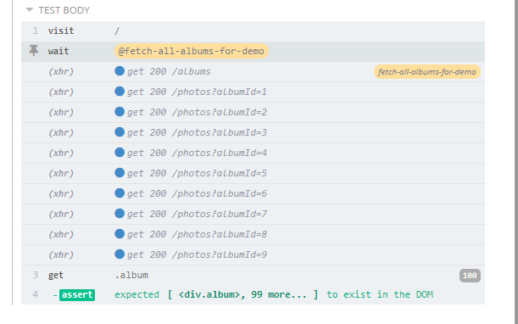
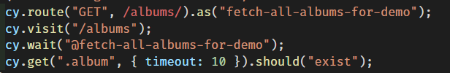
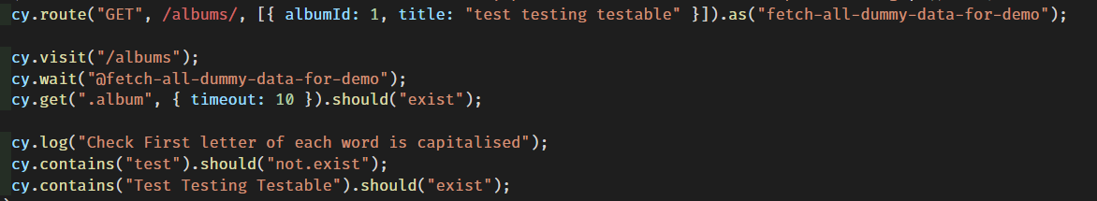
Better Options
Without mocking the data – just wait for the request to be made
and respond (also gives it a name in the console)
With mock data you can do environment agnostic tests
Notes:
Cypress also provides some better options, you can without mocking or stubbing any data give a web request and alias and wait for it to be called, this has the added benefit of giving it a nice label in the test runner. With mock data you can however also test completely in isolation which is both faster and more reliable.

Slide 30
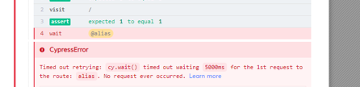
The more you know
Fetch not fully handled – but there is experimentalFetchPolyfill
The default retry timeout can be overridden
Timeouts create a minimum execution time
Notes:
And a couple of final notes on this.
Its possible that wait doesn’t work with fetch but there is a work around but this might already be included by now. and also that the retry timeout can be overridden which might be useful in some scenarios but still has potential drawbacks.
It might even make sense to reduce or remove it to highlight issues sooner.

Slide 31
Some Good Ideas / “Best” Practices
Use data-* attributes to provide context to your selectors
Test in isolation
Tests should run independently
Unit Tests != Integration Tests != End to End Tests
Test Flows
Test integrations, but not all of them at once, mock/stub sensibly
Notes:
Some other good practices from the cypress documentation
Don’t use css classes to reference the elements these are much more likely to change and generally have a meaning in terms of style while for clarity sake ideally everything should have at most a single responsibility.
Testing in isolation and having tests run independently is a more general maxim for writing tests I’m sure we've heard before,
And finally one that’s a little bit vague and full of opinion, but Unit, Integration and End to End tests are not same thing, regarding cypress and where I think it fits in the pyramid. test the flow, test the integrations but you don’t need to test them all, all of the time

Slide 32
Notes:
So back to this monster of test we can split it out into its individual flows

Slide 33
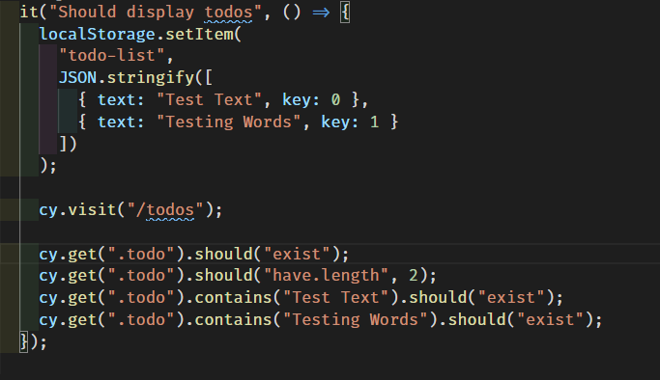
Notes:
First lets test the display if a to do,
We mock some test data because we need to avoid the add flow
We visit todos and then we check it displays correctly
This could later also test localisation, display quirks, sorting, ordering etc and then be split further.

Slide 34
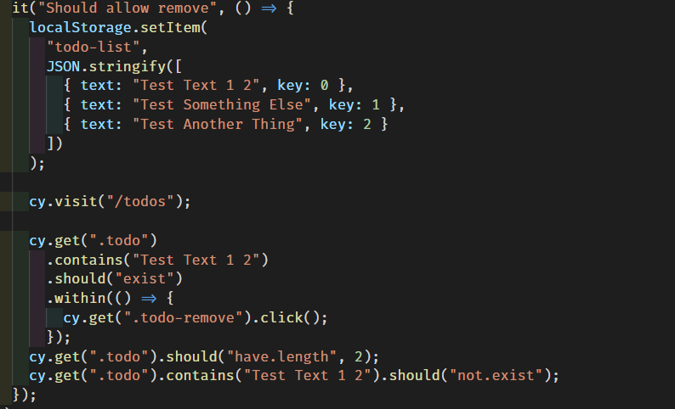
Notes:
Then we have a similar test for delete, after mocking some data in local storage. and we will come back to this, it
Checks that a todo element containing the correct test exists and within the element containg the text that there is a delete button and clicking on it should reduce the number of todos to 2 and have removed the expected item

Slide 35
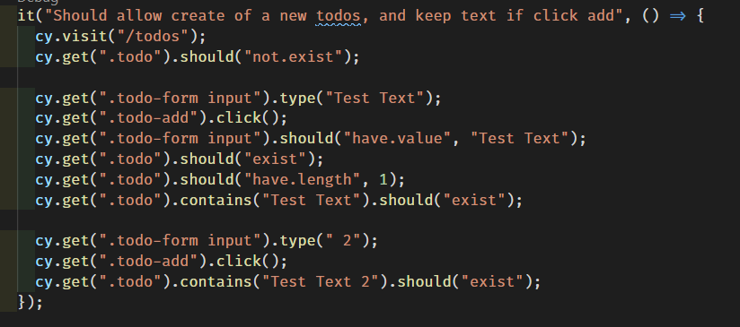
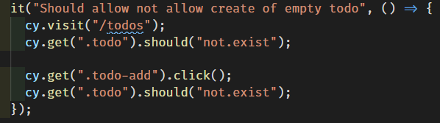
Notes:
Similarly we have a test for add and test for the validation which prevents add

Slide 36
Notes:
And finally with a bit of a different style a more complicated flow
Which goes to the visit page
Checks nothing exists
Checks that adding and clearing will both add an item and clear the text box
And the adding more text and adding without clearing will add the expected text

Slide 37
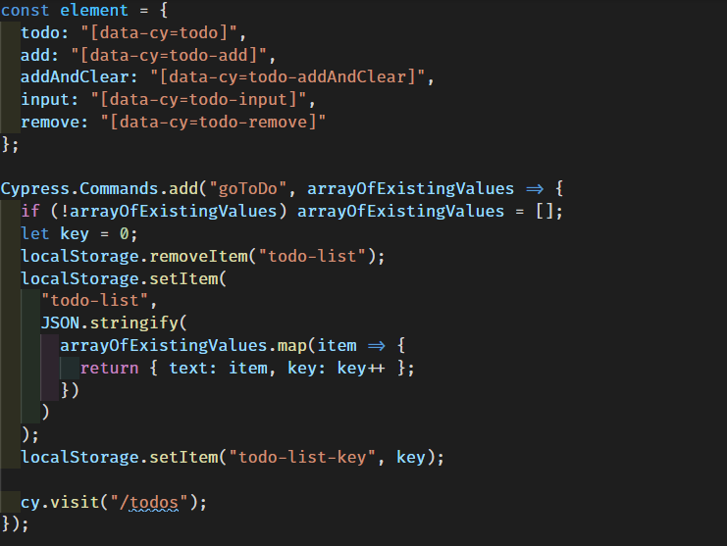
Notes:
With some further refactoring we separate out some of the shared code.
First off taking the element selectors and just storing them an object, this allows 2 things, we can name the selectors nicely and also update them from one place.
Secondly making use of the final cypress feature I would like to highlight, which is cypress commands.
These commands allow you to add a globally accessible feature to your testing framework
And can really help to keep reuse tidy.
Here the goToDo will accept an optional array of existing values, prepare this initial data if provided and reset the to do page to this default and visit the page.

Slide 38
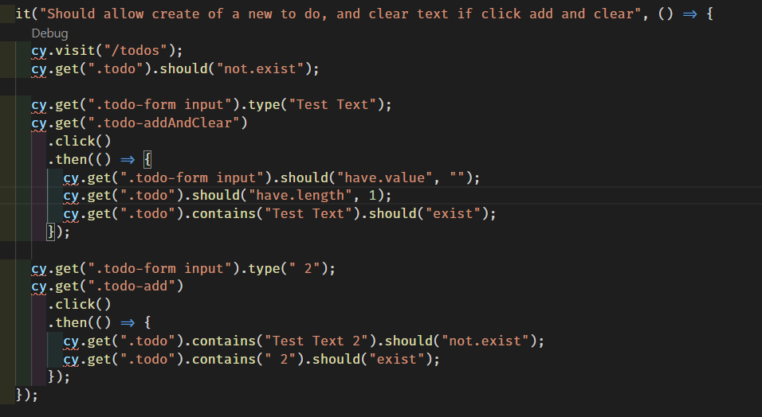
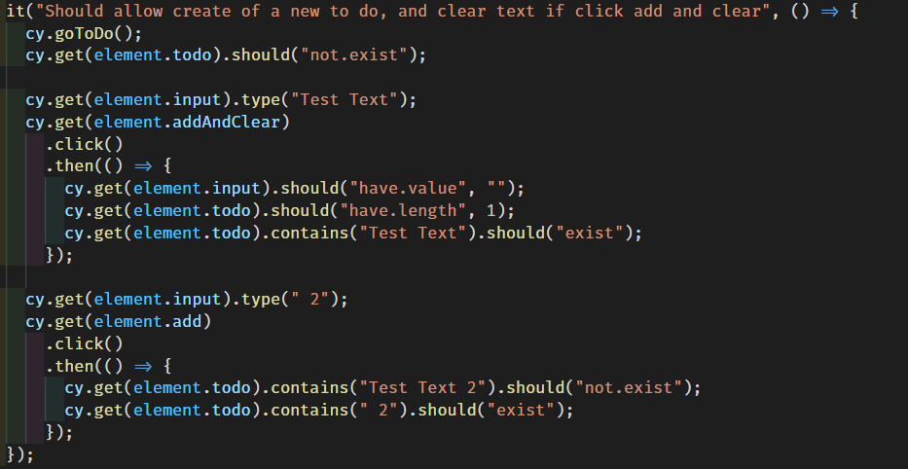
Notes:
The results of this are subtle we can see cy.visit replaced with cy goToDo While the selectors become more readable in my opinion

Slide 39
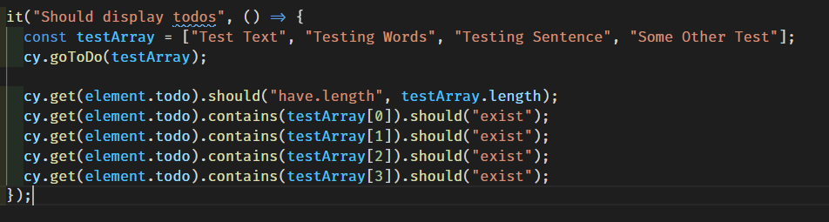
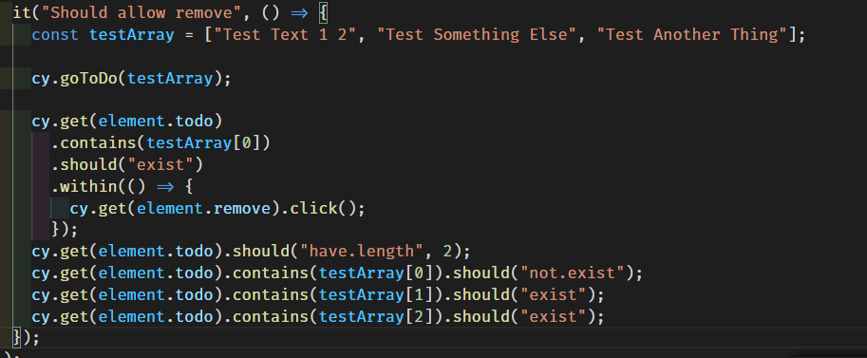
Notes:
Then as a better example we can see here the simplification of the tests which provides for both display and remove
Since the test shouldn’t care how the test data is setup, only that it is.
And this it, we are done, we have a well designed testing frame, that should be easy to understand extend and maintain.
However as this system grows this will fluctuate

Slide 40

System Design / Design Patterns Intended to make software designs more understandable, flexible and maintainable
Whether it is intentional, systematic and consistent throughout, an organic spaghetti free for all or something in-between.
Once your code does multiple thing it starts to become a system, and it will have a design, chosen or evolved.
Methodologies exist to guide this process
Xtreme Programming
Clean Architecture
SOLID
How you separate your code (and name things) will affect how understandable, flexible and maintainable it will be.
Notes:
Which allows me to touch briefly on another subject that is close to my heart but is too big to cover in any real depth today. System design and design patterns that are intended to do just that
Whether its intentional or not systems have a design.
Of course every system has different requirements and these problems are not simple so each solution is unique.
But there are various software methodologies which try to address these problems and help think about the final solution in a sometimes frustratingly abstract manner
They tend to boil down to one thing though, how you separate your code and name things.
What I want to impress upon you is that testing systems are still primarily code solutions and therefore will suffer from the same problems and same debatable solutions which are both full of macro and micro decisions.

Slide 41
Challenge Time
How Maintainable, How Flexible is this set of tests?
Restyle ToDos with material UI
Remove all existing css styling classnames
How many changes are needed to fix the tests? (Could this have been less?)
Consider we were to add the ability to edit.
Notes:
And so now that ive gotten up onto my soap box, I can talk the talk but can I walk the walk?
Lets see how these tests hold up, implement material ui and completely restyle the application.
Which means removing all the css classnames because they were custom
Lets not be cocky, when the test fail, what sort of change are required to fix these tests and how obvious would be to find them etc.

Slide 42
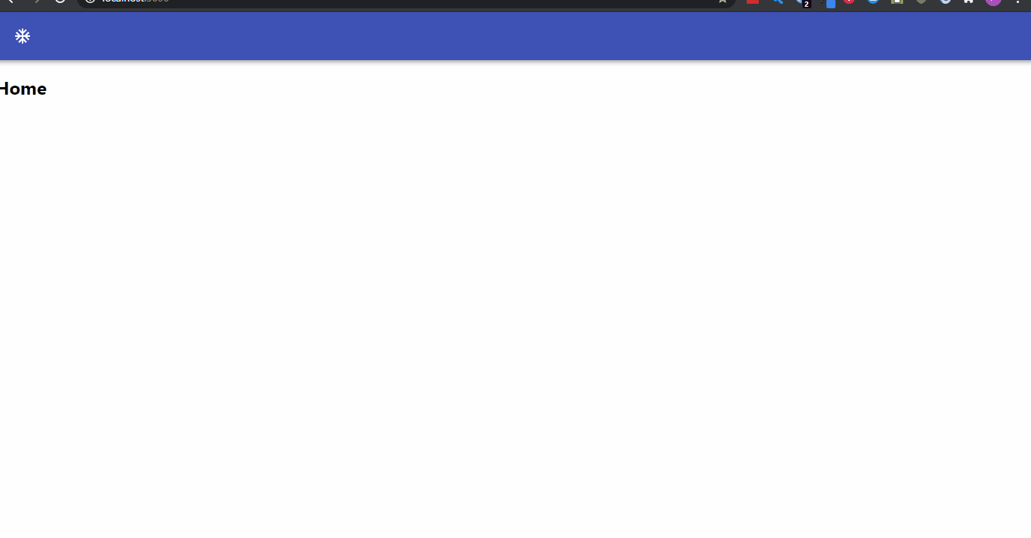
Restyled with Material-UI
Notes:
So restyled, it looks a lot better but the functionality is all the same
It still allows the user to add and clear the text box, to add and keep the contents of the text and then also to remove.
In theory the functionality didn’t change and so the tests should still pass, right?

Slide 43
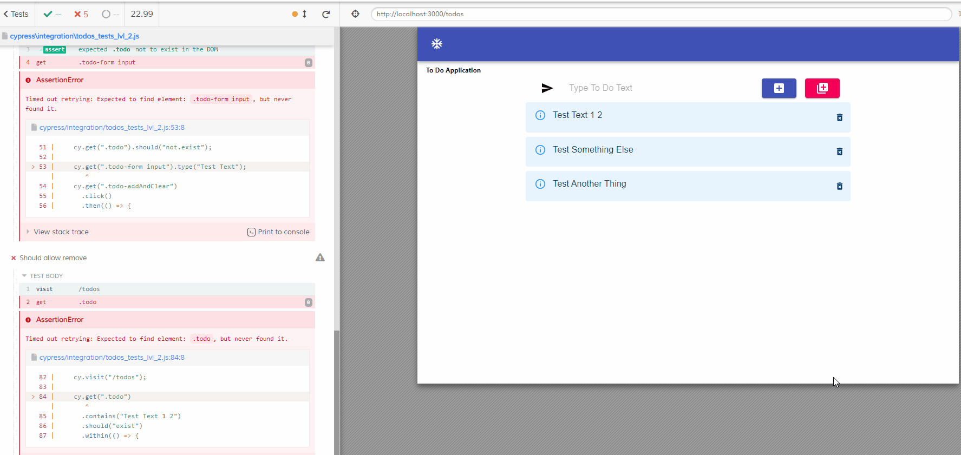
Notes:
So first a bit a cheat, I was using css classes before and I knew material ui would mean replacing them so of course all these test fail and the fail fast.

Slide 44
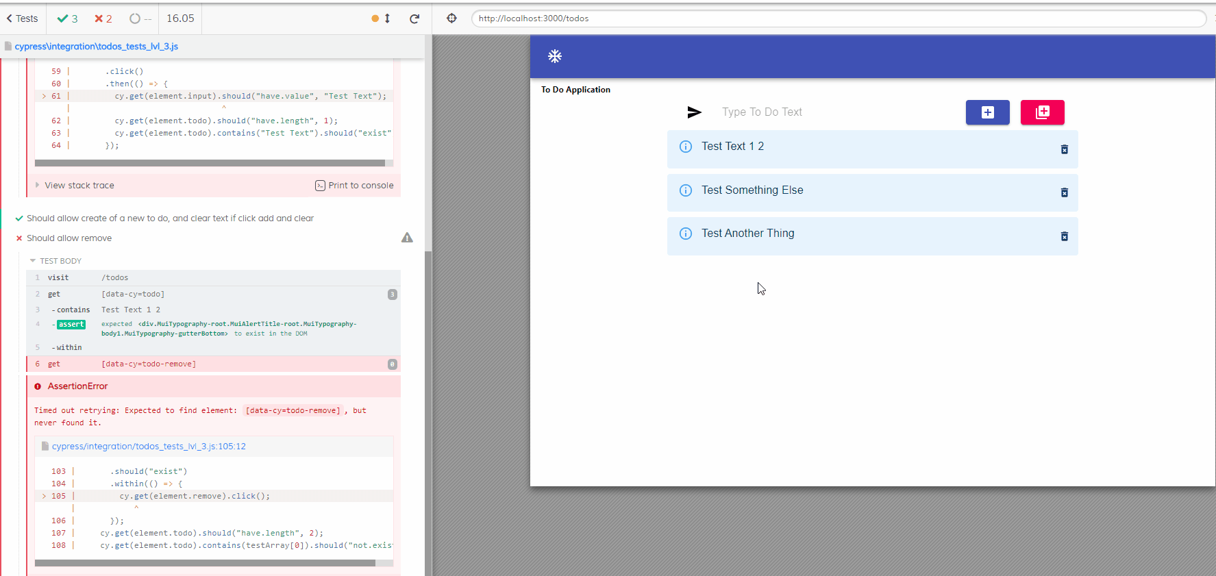
Notes:
But what about the data selectors, they stop this from being an issue right?
Not quite, but 2/3 isn't bad, even if the tests are simple I was quite happy this result in the end
And we will see why, give what takes to fix these issues

Slide 45
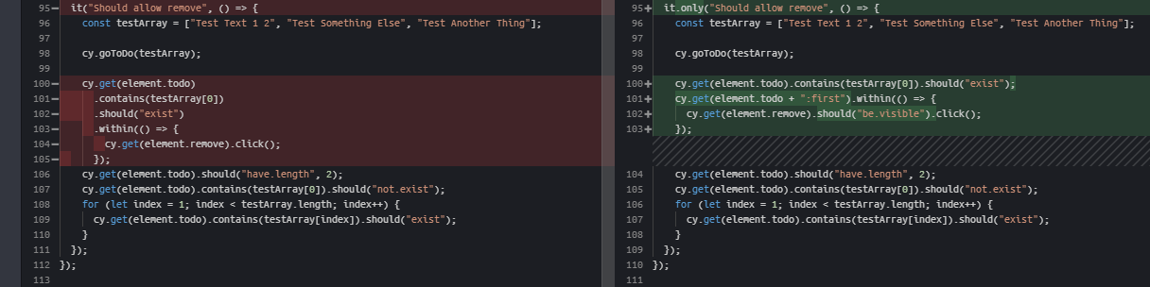
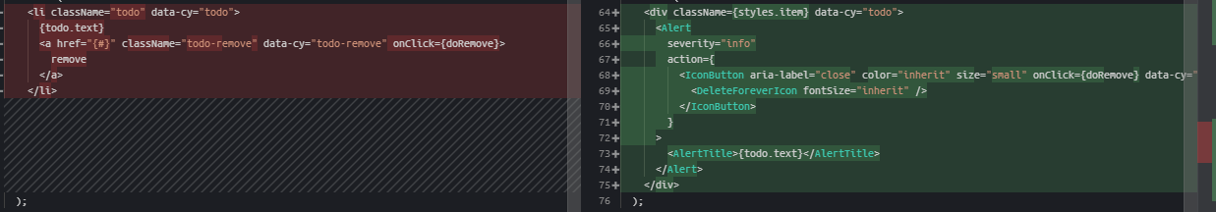
Because the Html changed
Notes:
First of all the structure of the input has changed because material ui uses fancy styling to wrap the input, so it actually exists inside of the original element
While and I mentioned we would come back to this, the structure of the todos has changed such that the button is no longer inside the element that contains the text, however a quick change to just remove the “first” todo and find the element contained within it (Show html)

Slide 46


Final Thoughts… Further Reading…
The Cypress documentation!
The Xtreme Programming (XP) Wikipedia page, most design “methodologies” begin here.
Some food for thought the next time you are trying to decide whether to (yes!) and how to (systematically!) split up the next system you work on.
Spare a thought for your future self
Keep it simple stupid
You ain’t gonna need it
Three strikes and you refactor (The Rule of 3)
Notes:
Of course the cypress documentation is a good start.
The Xtreme Programming wiki page is a pretty good starting point, its where most of these methodologies began, came about with object orientation in the 90s and even if it only gives you the sorts of questions you should ask yourself without worrying too much what it suggests the solutions are, it can help identify what is important to worry about even if you just building the system yourself freeform without a prescriptive plan.
In a way design patterns are a bit like philosophy, they suggest general answers to general question but specific answers you have to find yourself
Essentially you trying to create a system which you can come back to in 6 months or a years time after working on something entirely different,
Although it is also a balance, of the value of your time now vs the only potential cost to your time later.
There are various slogans that try to embody this balance, in general it means keeping things as simple as possible and only creating complexity when you are doing the same thing in multiple places Only have the level of complication that you require.

Slide 47
Questions ?
Notes:
Of course the cypress documentation is a good start.
The Xtreme Programming wiki page is a pretty good starting point, its where most of these methodologies began, came about with object orientation in the 90s and even if it only gives you the sorts of questions you should ask yourself without worrying too much what it suggests the solutions are, it can help identify what is important to worry about even if you just building the system yourself freeform without a prescriptive plan.
In a way design patterns are a bit like philosophy, they suggest general answers to general question but specific answers you have to find yourself
Essentially you trying to create a system which you can come back to in 6 months or a years time after working on something entirely different,
Although it is also a balance, of the value of your time now vs the only potential cost to your time later.
There are various slogans that try to embody this balance, in general it means keeping things as simple as possible and only creating complexity when you are doing the same thing in multiple places Only have the level of complication that you require.

